Slide 1
Topic Modeling (Latent Dirichlet Allocation)
Dr. M. Taimoor Khan

Slide 3
Topic Modeling
A type of statistical modeling for discovering the abstract “topics” in a collection of documents
Latent Dirichlet Allocation (LDA) is the dominant topic modeling approach
It performs well for having a strong mathematical grounding, even without considering word semantics
Treat words as symbols, so can be applied to any type of data where words may be replaced with phone calls, cars, medicines etc.
It is used to group words in document into particular topics
It’s a type of soft or fuzzy clustering that assign words to multiple clusters with different proportions

Slide 4
Latent Dirichlet Allocation (LDA)
Group words together based on their contextual correlation (occurring together in a document) across many documents
Predict a topic structure that would have generated the documents
Each topic represent a theme (concept) discussed in the dataset and is represented by the most significant words in that topic
It follows a Bag-of-Words (BoW) approach, assuming that all words within a document are exchangeable i.e., the order of the word doesn’t matter but only the count does

Slide 5
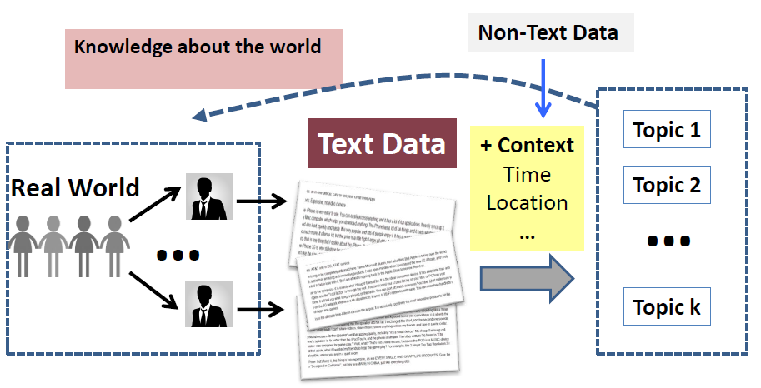
Topics as knowledge about the world

Slide 6
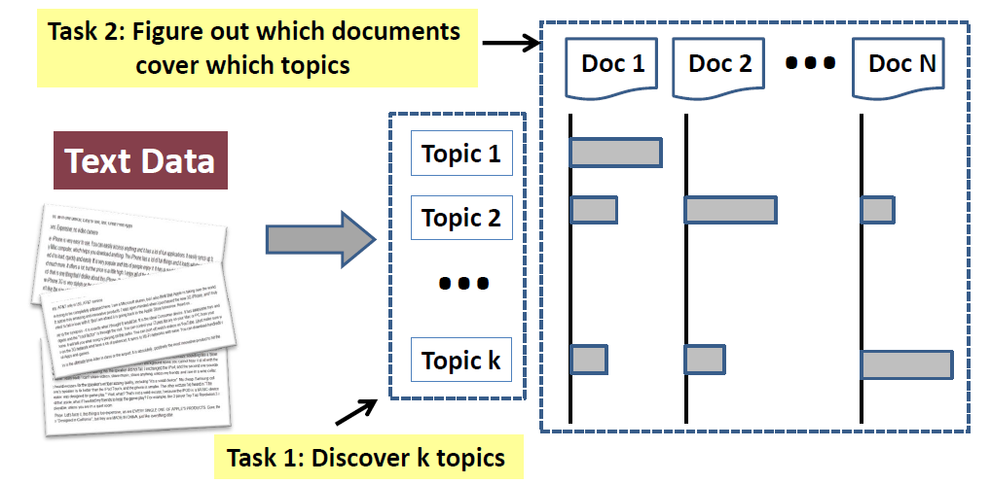
Tasks of topic mining and analysis

Slide 7
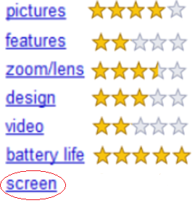
Unsupervised Aspect Extraction
Why Unsupervised!
Exploration
Can scale-up to big data
Cost effective
Unsupervised
Frequency relation based
Template based
Topic models

Slide 8

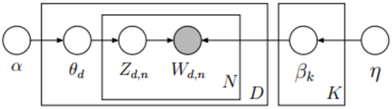
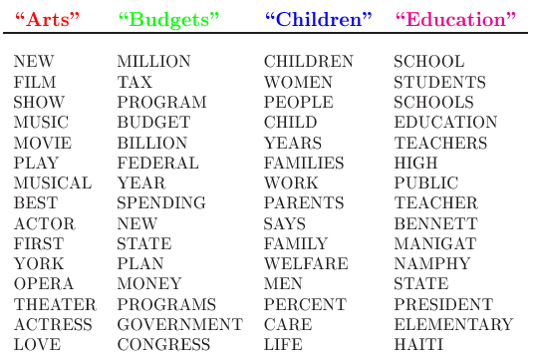
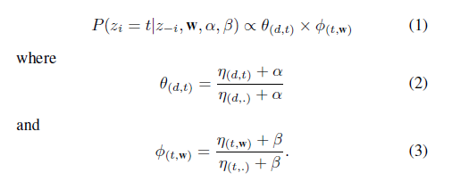
Topic Models
[1] D. M. Blei, A. Y. Ng, and M. I. Jordan, “Latent dirichlet allocation,” Journal of machine Learning research, vol. 3, no. Jan, pp. 993–1022, 2003.

Slide 9
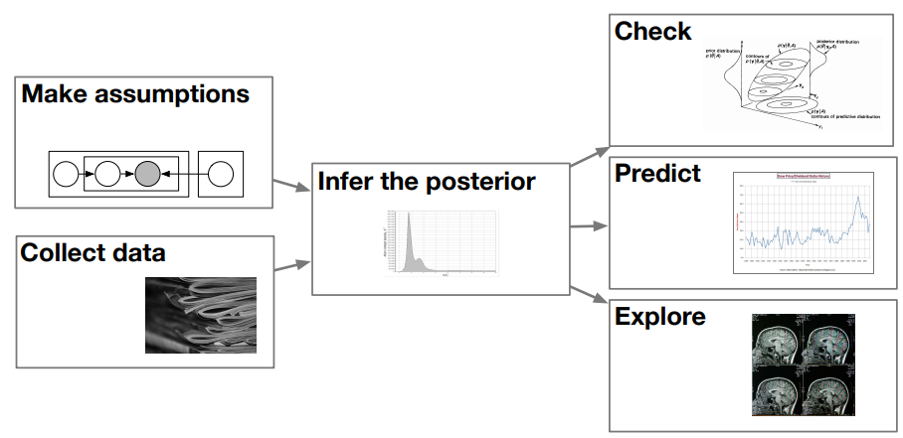

Slide 10
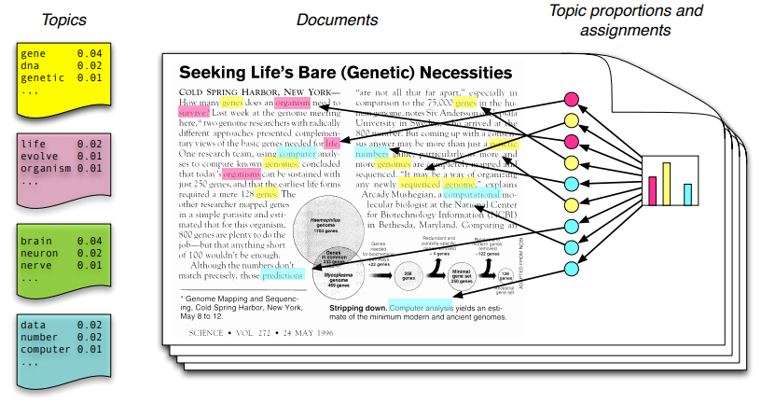
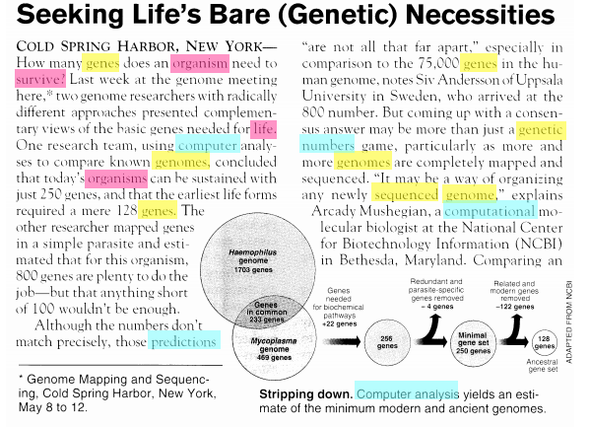

Slide 11
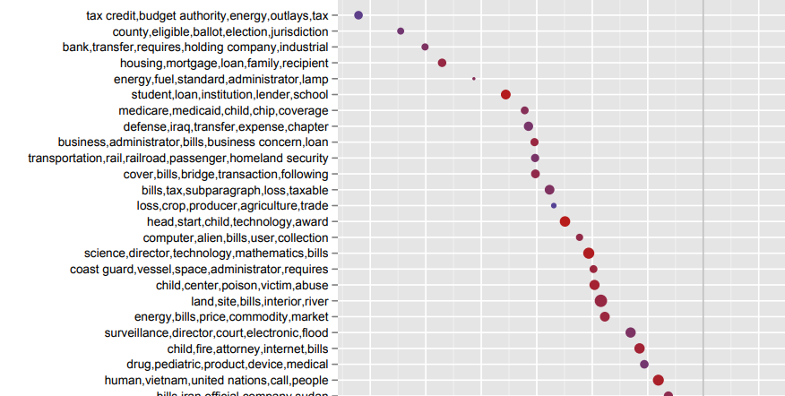

Slide 12
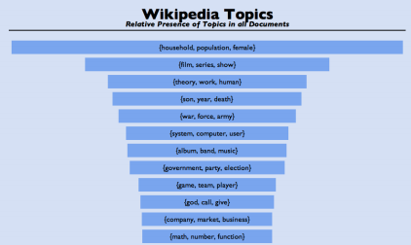

Slide 13
As Generative Model
It’s a specific kind of Machine Learning Technique that not only separate words into clusters but also predict the latent topic structure that could have generated the documents in the dataset
It empowers topic models to generate new documents like the ones existing in the dataset
Such newly generated documents are different representations of summary of the whole dataset as a single document
Moreover, the number of topics and their proportions in a new document can also be controlled i.e., generating new documents using only one or few of the topics with given proportions

Slide 14
Topic Modeling Applications
Explore an unknown domain
Identifying valuable information in specialized domains with no prior knowledge
Dimensionality reduction
Feature extraction for classifiers
Write new documents (summaries of one or few topics)
Suggest readings according to topics of interest
Suggest words to consider for search in information retrieval systems

Slide 15
Demonstration

Slide 16
Dataset (of 4 documents)
D₀ = bread bread bread bread bread bread bread bread bread bread
D₁ = milk milk milk milk milk milk milk milk milk milk
D₂ = chair chair chair chair chair chair chair chair chair chair
D₃ = bread bread bread bread bread bread bread bread bread bread milk milk milk milk milk milk milk milk milk milk
Topic models require high number of document samples to better predict model. We have only 4 documents therefore, we are enforcing high correlation by repeatedly using same words

Slide 17
Pre-processing
We are using:
Tokenization: Spitting each document to a sequence of tokens (words)
We are not using:
Stemming and lemmatization to shorten words to their stems i.e., beauty, beautify, beautification, beautifully to beauty. It reduces the number of unique tokens and accumulate their probabilities that helps in better prediction
Case conversion, stop words removal, filtering unknown symbols…

Slide 18
Preparing Data
//we will need to generate random nos
import java.util.Random;
public class LDA
{
//vocabulary size
private int V = 3;
//Dataset size
private int D = 4;
//vocabulary
private String words[] = new String[V];
//corpus
private int docs[][] = new int[D][];
…
}
Dictionary or Vocabulary = {bread, milk, chair}
Vocabulary size, V = 3
Assigning Unique IDs to words (tokens) to simplify
w₀ = bread
w₁ = milk
w₂ = chair
The documents are represented as,
D₀ = {w₀, w₀, w₀, w₀, w₀, w₀, w₀, w₀, w₀, w₀}
D₁ = {w₁, w₁, w₁, w₁, w₁, w₁, w₁, w₁, w₁, w₁}
D₂ = {w₂, w₂, w₂, w₂, w₂, w₂, w₂, w₂, w₂, w₂}
D₃ = {w₀, w₀, w₀, w₀, w₀, w₀, w₀, w₀, w₀, w₀, w₁, w₁, w₁, w₁, w₁, w₁, w₁, w₁, w₁, w₁}

Slide 19
Setting Initial Parameters
public class LDA
{
…
private int T = 2;
private int gsIterations = 1000;
…
}
Number of Topics, T = 2
Topics are: T_{o} and t₁
Gibbs Sampler iterations, gsIterations = 1000;
Stopping criteria for the inference technique i.e., Gibbs sampler
The distribution is expected to reach equilibrium in these iterations

Slide 20
Model’s hyper-parameters (Alpha & Beta)
public class LDA
{
…
private double Alpha = 1.0;
private double Beta = 0.1;
…
}
Alpha = 1.0
Mixture of topics in documents
Beta = 0.1
Mixture of words in topics
Effect of different values for Alpha and Beta are discussed later

Slide 21
Variables (maintaining state of the model)
public class LDA
{
…
private double theta[][] = new double[D][T];
private double phi[][] = new double[T][V];
private int z[][] = new int[D][];
…
}
theta[d][t]
Distribution of a topic t in a document d
phi[t][w]
Distribution of a word w in a topic t
z[d][wo]
Label for a word occurrence wo in a document d

Slide 22
Constructor (Read Data)
public class LDA
{
…
public LDA(){
words[0] = “bread”;
words[1] = “milk”;
words[2] = “chair”;
docs[0] = new int[] {0, 0, 0, 0, 0, 0, 0, 0, 0, 0};
docs[1] = new int[] {1, 1, 1, 1, 1, 1, 1, 1, 1, 1};
docs[2] = new int[] {2, 2, 2, 2, 2, 2, 2, 2, 2, 2};
docs[3] = new int[] {0, 0, 0, 0, 0, 0, 0, 0, 0, 0,
1, 1, 1, 1, 1, 1, 1, 1, 1, 1};
…
}
…
}
Dictionary or Vocabulary = {bread, milk, chair}
Vocabulary size, V = 3
Assigning Unique IDs to words (tokens) to simplify
0 = bread
1 = milk
2 = chair
The documents are represented as,
D₀ = {0, 0, 0, 0, 0, 0, 0, 0, 0, 0}
D₁ = {1, 1, 1, 1, 1, 1, 1, 1, 1, 1}
D₂ = {2, 2, 2, 2, 2, 2, 2, 2, 2, 2}
D₃ = {0, 0, 0, 0, 0, 0, 0, 0, 0, 0,
1, 1, 1, 1, 1, 1, 1, 1, 1, 1}

Slide 23
Constructor (Initialize distributions)
public class LDA
{
…
public LDA(){
…
for(int d=0; d<D; d++)
for(int t=0; t<T; t++)
theta[d][t] = 0;
for(int t=0; t<T; t++)
for(int w=0;w<V;w++)
phi[t][w] = 0;
}
…
}
The arrays theta and phi are responsible for maintaining the state of the model
Theta is the distribution of each topic in a document
Phi is the distribution of each word in a topic

Slide 24
Markov Chain Random Initialization
public class LDA
{
…
public MCMCInitialize(){
Random randNum = new Random();
for(int d=0; d<D; d++){
int N = docs[d].length;
z[d] = new int[N];
for(int n=0; n<N; n++){
int t = randNum.nextInt(T)%T;
z[d][n] = t;
}
}
}
…
}
The inference technique used i.e., Gibbs sampler is a markov chain technique that has each state dependent on its previous state
The model is given an initial state at random by assigning topics t Є[0, T-1] to word occurrences docs[d][n] at random
N is the total number of words in a document that varies from doc to doc
For a word occurrence docs[d][n], its corresponding topic is stored in z[d][n]

Slide 25
Why Random!
Gibbs sampler keep sampling a topic for each word occurrence that is suitable according to the current distribution of the model (state) to give the model a new state
A word occurrence has its topic reconsidered for update, where a suitable topic at current state may be the existing topic or a different one
Each word occurrence each document is revisited for a possible topic update in each iteration of the Gibbs Sampler
The process repeats for the gsIterations times

Slide 26
At this point the model is expected to obtain the desired equilibrium distribution
Although the subsequent states are dependent on each other, however, for the 1000th state it hardly matters what the 1st state was
Having said that, with a better initial state, the model will require fewer iterations to obtain the desired equilibrium distribution but evaluating such an initial state incur computational cost of its own

Slide 27
Assuming the topics assigned to each in each document are:
For the following documents,
docs[0] = {0, 0, 0, 0, 0, 0, 0, 0, 0, 0}
docs[1] = {1, 1, 1, 1, 1, 1, 1, 1, 1, 1}
docs[2] = {2, 2, 2, 2, 2, 2, 2, 2, 2, 2}
docs[3] = {0, 0, 0, 0, 0, 0, 0, 0, 0, 0, 1, 1, 1, 1, 1, 1, 1, 1, 1, 1}
Lets assume the topics assigned to each of its word are,
Z[0] = {0, 0, 1, 1, 1, 0, 0, 0, 1, 1}
Z[1] = {1, 1, 0, 1, 1, 0, 0, 1, 1, 0}
Z[2] = {1, 0, 1, 0, 0, 0, 1, 1, 0, 0}
Z[3] = {1, 0, 0, 1, 1, 0, 1, 1, 0, 0, 1, 1, 1, 0, 1, 1, 0, 1, 1, 1}
E.g. the word occurrence docs[1][6] has unique word ID=1 and its topic Z[1][6]=0

Slide 28
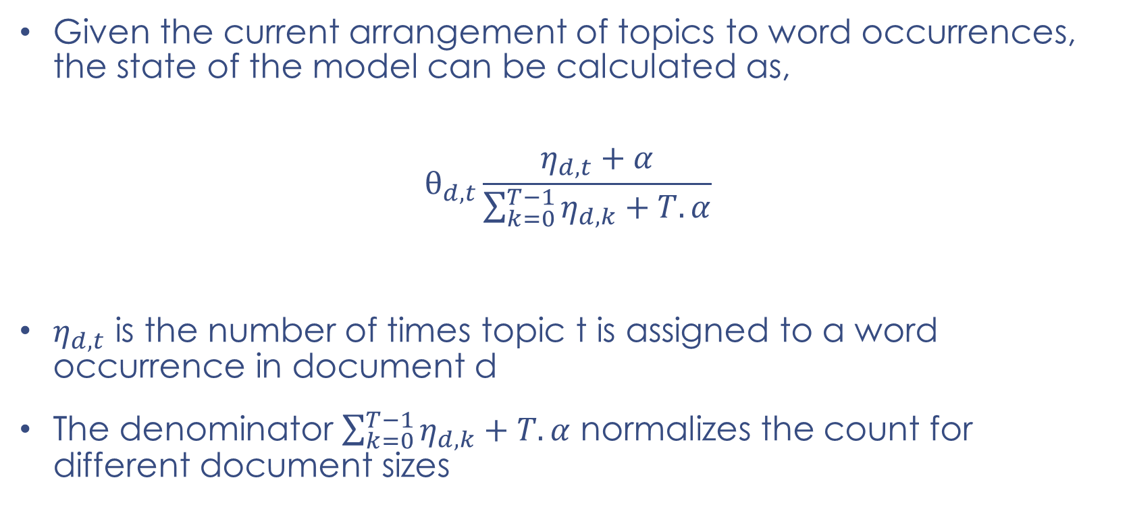

Model State ($θ$ and $φ$)
Given the current arrangement of topics to word occurrences, the state of the model can be calculated as,
$$θ_{d,t}\frac{η_{d,t}+α}{\sum_{k=0}^{T−1}{η_{d,k}}+T.α}$$
$η_{d,t}$ is the number of times topic t is assigned to a word occurrence in document d
The denominator $\sum_{k=0}^{T−1}{η_{d,k}}+T.α$ normalizes the count for different document sizes

Slide 29
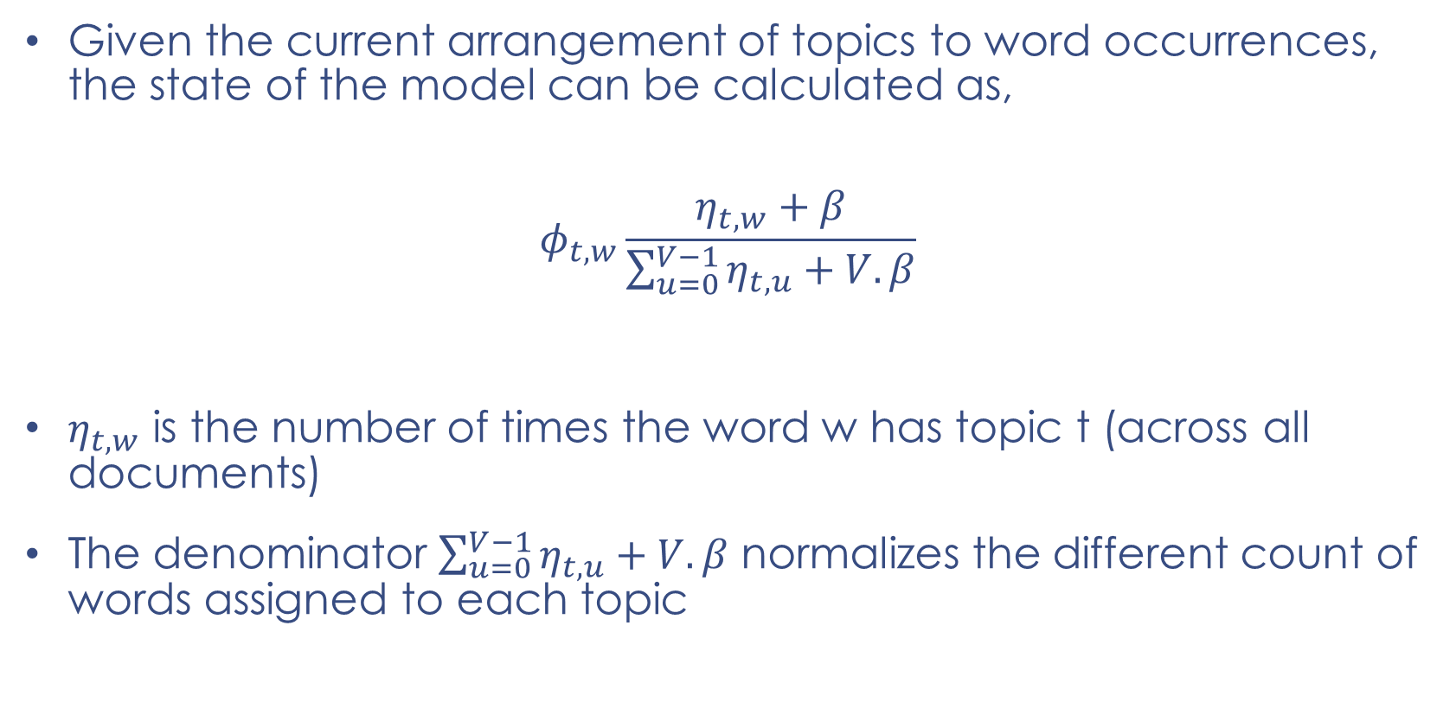
Model State ($θ$ and $φ$)
Given the current arrangement of topics to word occurrences, the state of the model can be calculated as,
$$φ_{t,w}\frac{η_{t,w}+β}{\sum_{u=0}^{V−1}{η_{t,u}}+V.β}$$
$η_{t,w}$ is the number of times the word w has topic t (across all documents)
The denominator $\sum_{u=0}^{V−1}{η_{t,u}}+V.β$ normalizes the different count of words assigned to each topic

Slide 30
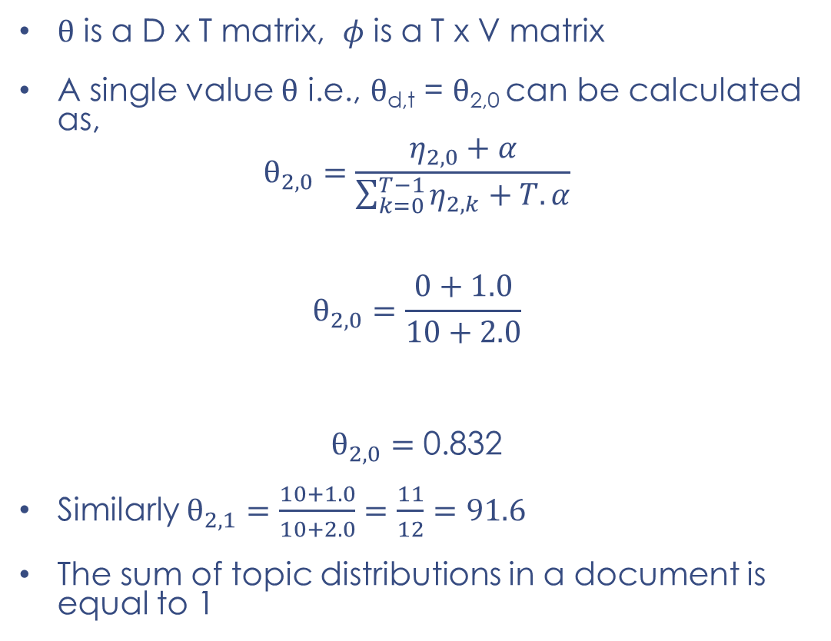
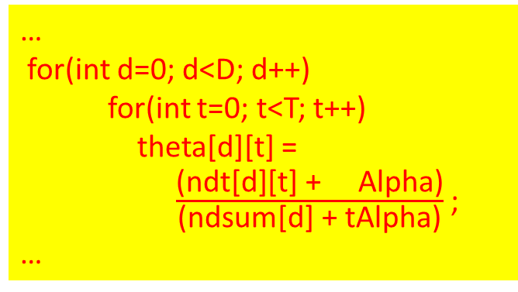
Model State ($θ$ and $φ$)
…
for(int d=0; d<D; d++)
for(int t=0; t<T; t++)
theta[d][t] = $\frac{\text{(}\text{ndt}\text{[}\text{d}\text{][}\text{t}\text{] + }\text{Alpha}\text{)}}{\text{(}\text{ndsum}\text{[}\text{d}\text{] + }\text{tAlpha}\text{)}}$ ;
…
$θ$ is a D x T matrix, $φ$ is a T x V matrix
A single value $θ$ i.e., $θ$_{d,t} = $θ$_{2,0} can be calculated as,
$$θ_{2,0}=\frac{η_{2,0}+α}{\sum_{k=0}^{T−1}{η_{2,k}}+T.α}$$
$$θ_{2,0}=\frac{0+1.0}{10+2.0}$$
$θ_{2,0}=$ 0.832
Similarly $θ_{2,1}=\frac{10+1.0}{10+2.0}=\frac{11}{12}=91.6$
The sum of topic distributions in a document is equal to 1
ndt[d][t] : count of topic t in document d
ndsum[d] : count of all topics (word occurrences) in document d
tAlpha : T x Alpha
(instead of calculating them each time, we store and maintain these values for better performance)

Slide 31
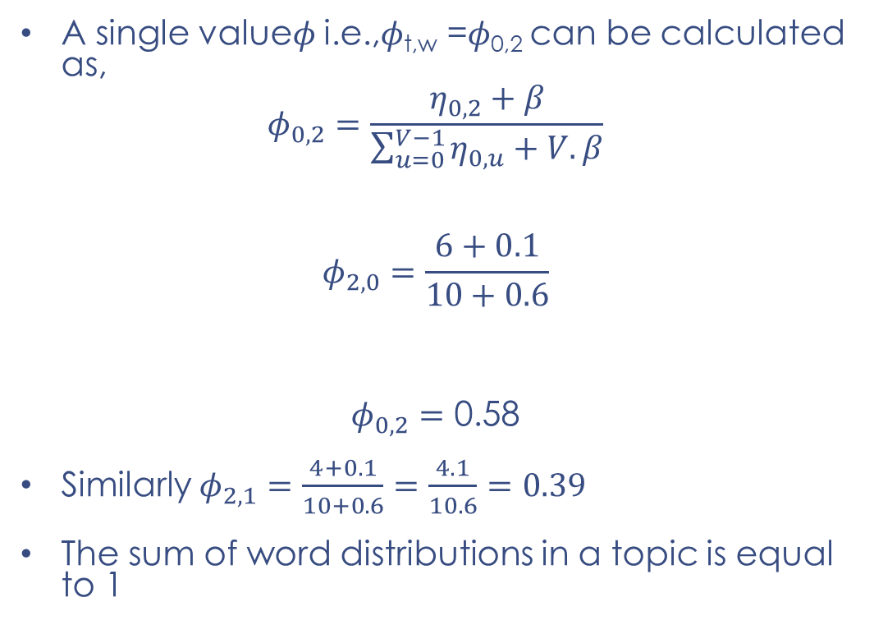
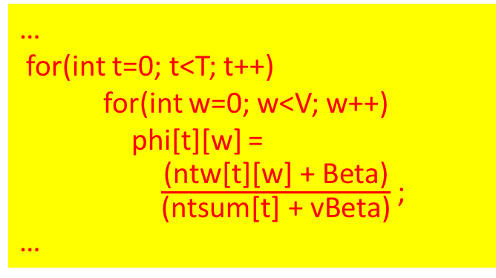
Model State ($θ$ and $φ$)
…
for(int t=0; t<T; t++)
for(int w=0; w<V; w++)
phi[t][w] = $\frac{\text{(}\text{ntw}\text{[}\text{t}\text{][}\text{w}\text{] + }\text{Beta}\text{)}}{\text{(}\text{ntsum}\text{[}\text{t}\text{] + }\text{vBeta}\text{)}}$;
…
A single value$φ$ i.e.,$φ$_{t,w} =$φ$_{0,2} can be calculated as,
$$φ_{0,2}=\frac{η_{0,2}+β}{\sum_{u=0}^{V−1}{η_{0,u}}+V.β}$$
$$φ_{2,0}=\frac{6+0.1}{10+0.6}$$
$φ_{0,2}=$ 0.58
Similarly $φ_{2,1}=\frac{4+0.1}{10+0.6}=\frac{4.1}{10.6}=0.39$
The sum of word distributions in a topic is equal to 1
ntw[t][w] : count of word w occurrences having topic t
ntsum[t] : count of all words having topic t
vBeta : V x Beta
(instead of calculating them each time, we store and maintain these values for better performance)

Slide 32
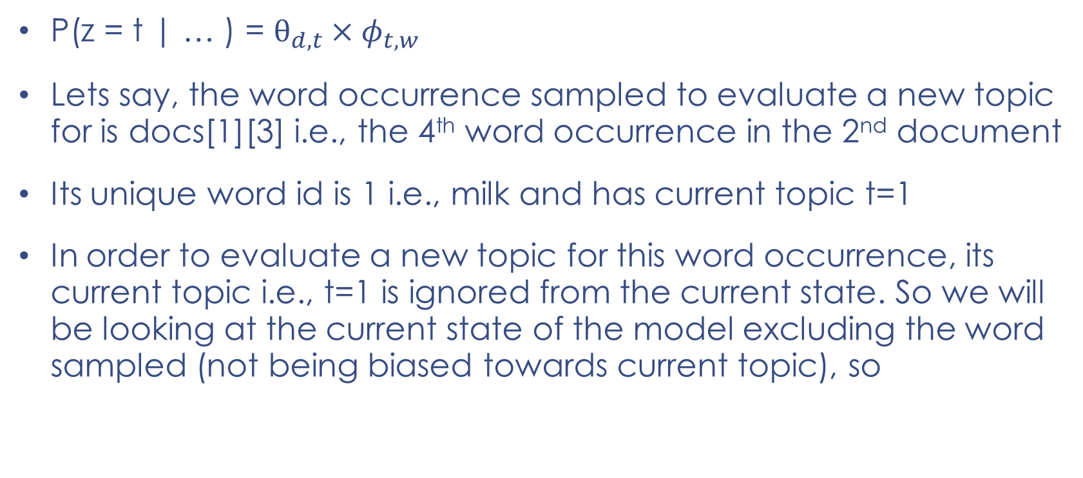
Evaluating a new topic for a word occurrence
P(z = t | … ) = $θ_{d,t}×φ_{t,w}$
Lets say, the word occurrence sampled to evaluate a new topic for is docs[1][3] i.e., the 4th word occurrence in the 2nd document
Its unique word id is 1 i.e., milk and has current topic t=1
In order to evaluate a new topic for this word occurrence, its current topic i.e., t=1 is ignored from the current state. So we will be looking at the current state of the model excluding the word sampled (not being biased towards current topic), so

Slide 33
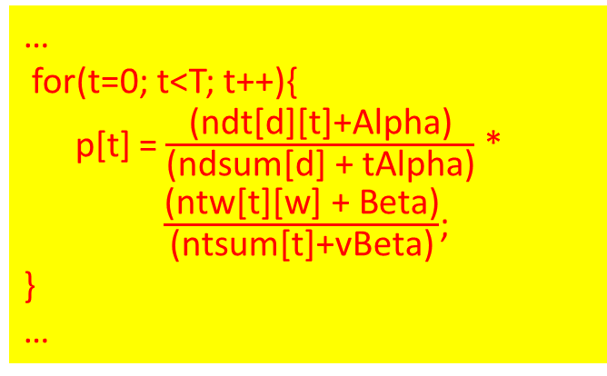
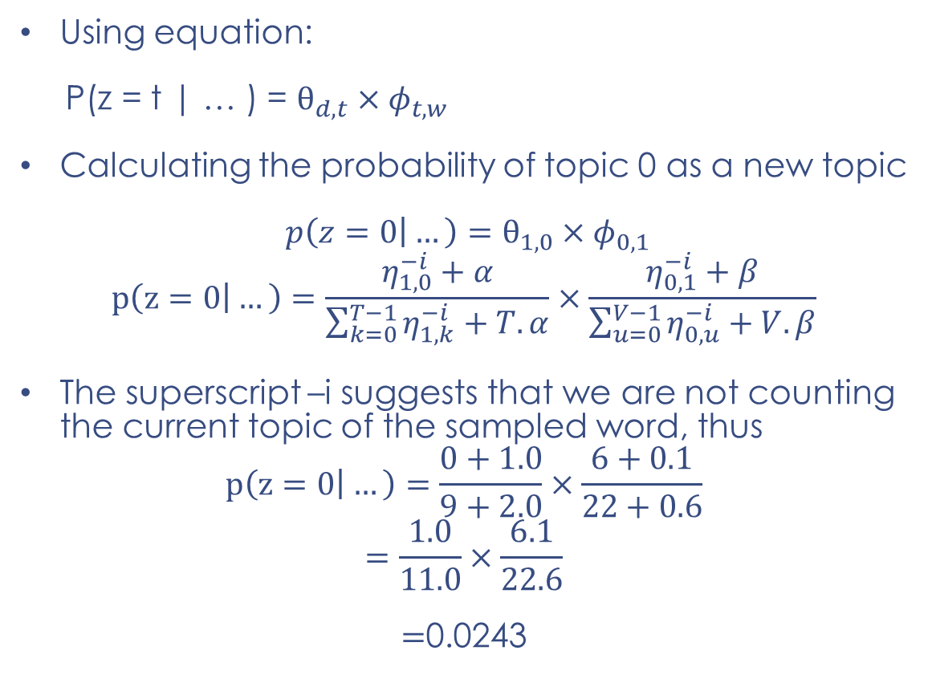
…
for(t=0; t<T; t++){
p[t] = $\frac{\text{(}\text{ndt}\text{[}\text{d}\text{][}\text{t}\text{]+}\text{Alpha}\text{)}}{\text{(}\text{ndsum}\text{[}\text{d}\text{] + }\text{tAlpha}\text{)}}$ *
$\frac{\text{(}\text{ntw}\text{[}\text{t}\text{][}\text{w}\text{] + }\text{Beta}\text{)}}{\text{(}\text{ntsum}\text{[}\text{t}\text{]+}\text{vBeta}\text{)}}$;
}
…
Using equation:
P(z = t | … ) = $θ_{d,t}×φ_{t,w}$
Calculating the probability of topic 0 as a new topic
${p\left(z=0 | …\right)=θ}_{1,0}×φ_{0,1}$
$$p\left(z=0 | …\right)=\frac{η_{1,0}^{−i}+α}{\sum_{k=0}^{T−1}{η_{1,k}^{−i}}+T.α}×\frac{η_{0,1}^{−i}+β}{\sum_{u=0}^{V−1}{η_{0,u}^{−i}}+V.β}$$
The superscript –i suggests that we are not counting the current topic of the sampled word, thus
$$p\left(z=0 | …\right)=\frac{0+1.0}{9+2.0}×\frac{6+0.1}{22+0.6}$$
$$=\frac{1.0}{11.0}×\frac{6.1}{22.6}$$
$=$0.0243
ndt[d][t] : count of topic t in document d (-1 for sampled word’s topic)
ndsum[d] : count of all topics (word occurrences) in document d -1
ntw[t][w] : count of word w occurrences having topic t (-1 for sampled word’s topic)
ntsum[t] : count of all words having topic t -1

Slide 34
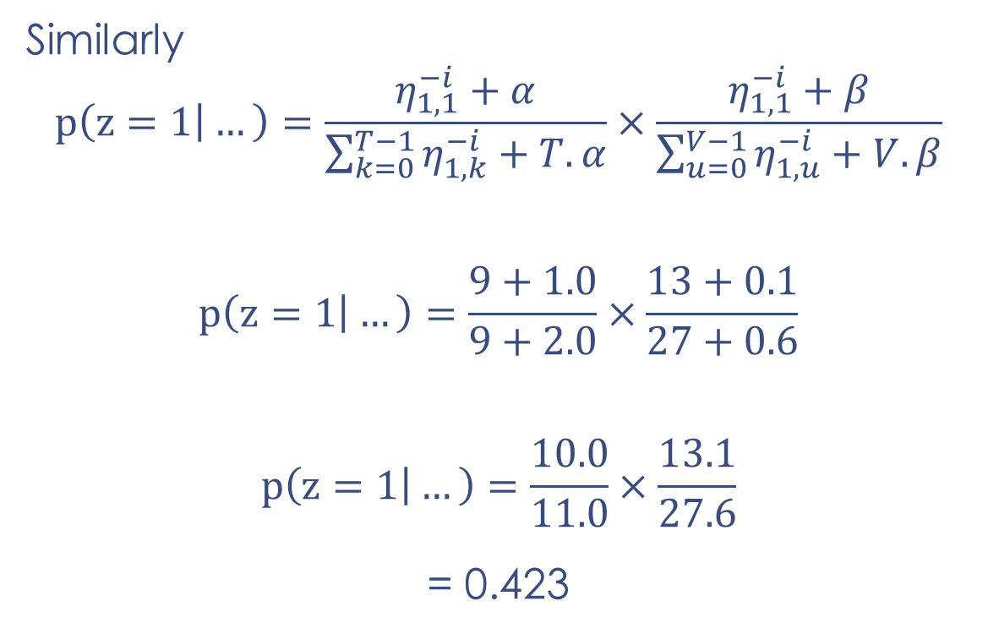
Similarly
$$p\left(z=1 | …\right)=\frac{η_{1,1}^{−i}+α}{\sum_{k=0}^{T−1}{η_{1,k}^{−i}}+T.α}×\frac{η_{1,1}^{−i}+β}{\sum_{u=0}^{V−1}{η_{1,u}^{−i}}+V.β}$$
$$p\left(z=1 | …\right)=\frac{9+1.0}{9+2.0}×\frac{13+0.1}{27+0.6}$$
$$p\left(z=1 | …\right)=\frac{10.0}{11.0}×\frac{13.1}{27.6}$$
= 0.423

Slide 35
For word occurrence docs[1][3] the likelihood of topic 0 is 0.0243 and that of topic 1 is 0.423
Thus, the word occurrence docs[1][3] having word ID 1 is most likely to retain its current topic i.e., topic 1
But, since it’s a probabilistic approach therefore, we cannot be certain that the appropriate topic for the sampled word at the current state is 1
Instead we will predict a topic, this time by being biased towards topic 1

Slide 36
In order to do so, we will use a scale s,
s = 0.0243 + 0.423
S = 0.4473
We will predict a random number between 0 and 0.4473, if it falls between 0 and 0.0243 then we will assign the word occurrence docs[1][3] topic 0 otherwise topic 1.
0 0.0243 0.4473

Slide 37
This is how a new topic is evaluated for a sampled word
Each word is sampled for evaluating a suitable topic for it in a single iteration of the Gibbs Sampler
The process repeats for gsIterations number of times

Slide 38
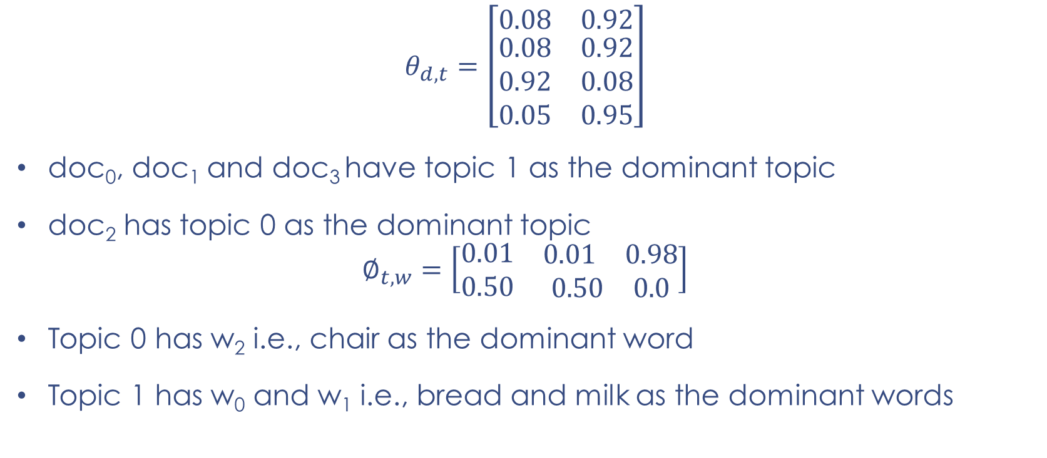
Fast-forward to the final distribution
$$θ_{d,t}=\left[\begin{matrix}0.08 & 0.92 \\ \begin{matrix}0.08 \\ 0.92 \\ 0.05\end{matrix} & \begin{matrix}0.92 \\ 0.08 \\ 0.95\end{matrix}\end{matrix}\right]$$
doc₀, doc₁ and doc₃ have topic 1 as the dominant topic
doc₂ has topic 0 as the dominant topic
$$∅_{t,w}=\left[\begin{matrix}0.01 & \begin{matrix}0.01 & 0.98\end{matrix} \\ 0.50 & \begin{matrix}0.50 & 0.0\end{matrix}\end{matrix}\right]$$
Topic 0 has w₂ i.e., chair as the dominant word
Topic 1 has w₀ and w₁ i.e., bread and milk as the dominant words

Slide 39
What we get from this
Domain exploration
The dataset has two concepts discussed i.e., {bread, milk} and {chair}
Dimensionality reduction
Dimensions reduced from 3 (unique words) to 2 concepts
High dimensionality is a problem in textual data having sparse representation
Feature extraction
The two concepts identified can be used as features in a classifier
Any number of features required can be extracted

Slide 40
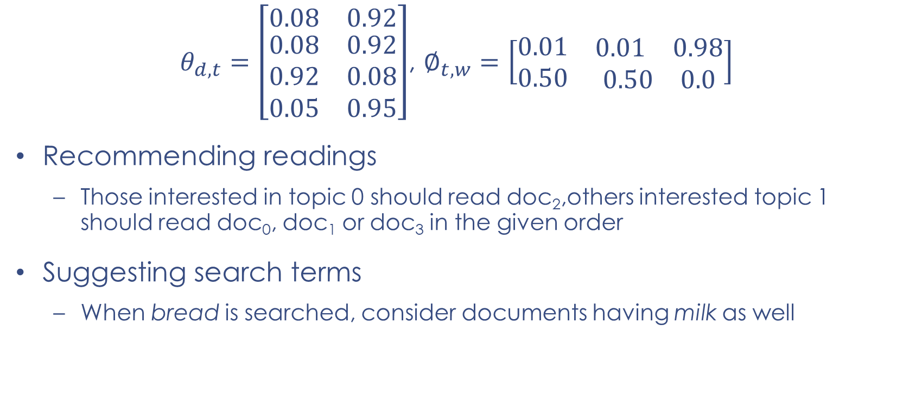
$θ_{d,t}=\left[\begin{matrix}0.08 & 0.92 \\ \begin{matrix}0.08 \\ 0.92 \\ 0.05\end{matrix} & \begin{matrix}0.92 \\ 0.08 \\ 0.95\end{matrix}\end{matrix}\right]$, $∅_{t,w}=\left[\begin{matrix}0.01 & \begin{matrix}0.01 & 0.98\end{matrix} \\ 0.50 & \begin{matrix}0.50 & 0.0\end{matrix}\end{matrix}\right]$
Recommending readings
Those interested in topic 0 should read doc₂,others interested topic 1 should read doc₀, doc₁ or doc₃ in the given order
Suggesting search terms
When bread is searched, consider documents having milk as well

Slide 41
As generative model, to write new documents
Sample a topic t from the given topics [0, 1] having equal chance for a topic to be picked
Sample a word w from the given words [0, 1, 2] having biased towards the probability of words in the chosen topic t e.g., in topic 0 word w2 i.e., chair will have high probability of being picked
The process can be repeated to write a document having as many words as desired
Any number of documents can be written following the same approach
Such document(s) would be a summary of the whole dataset

Slide 42
As a Generative Model
Generating specific documents
A new document may be restricted to focus on only one or few topics
The proportion of a topic may also be controlled in a new document e.g., writing a new document that would have 30% of topic 0 and 70% of t
Algorithm:
With a topic structure learnt from a collection of documents
Pick a topic at random (can be biased towards one or few topics)
Pick a word at random from that topic but biased towards words with higher probabilities in that topic
Write that word in the new document
Repeat for as many words as you like in the new document

Slide 43
Such a document is stuffing of the prominent words from the topics desired
However, it will require the human writer to convert them into proper sentences
It can serve as good tool to offer food for thought to write new articles and blogs when the words stuffed are from top trending stories

Slide 44
Performance
Burnin = 200
SampleLag = 20
The Burnin is set to 200 to update the model state after first 200 iterations as there is too much randomness in earlier iterations
To enhance performance we may update the model state every 20 iterations as the update in a single iteration is very little

Slide 45
Tweaking Alpha and Beta (for some prior knowledge)
Earlier we used the same value of Alpha as 1.0 across all documents i.e., assuming the distribution to be symmetric (equally proportionate)
A particular value can be used for each document, as Alpha = [1.3, 0.7, 1.0, 1.1] i.e., assuming the distribution to be asymmetric
A higher Alpha value for a document i.e., above 1 suggests that the document is made up of a mixture of more topics or all topics
Such document has more spread of different topics
This is when we know that more variety of topics are discussed in a document irrespective of what they are

Slide 46
A lower Alpha value for a document i.e., below 1 suggests that the document is made up of fewer topics or just one topic
One or few topics dominate such documents in high proportion
This is when we know before hand that the given document is about a specific topic of few topics while not know what they are
In practice a high Alpha value will lead to documents being more similar in terms of what topics they contain

Slide 47
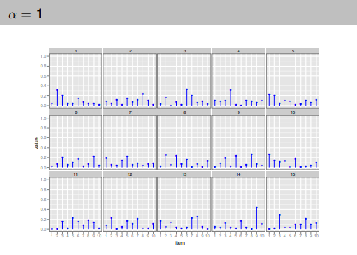
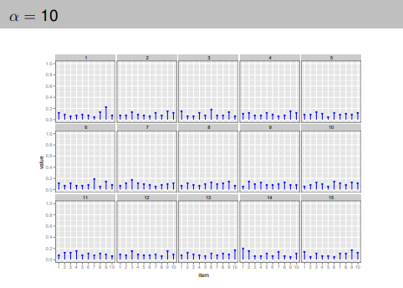
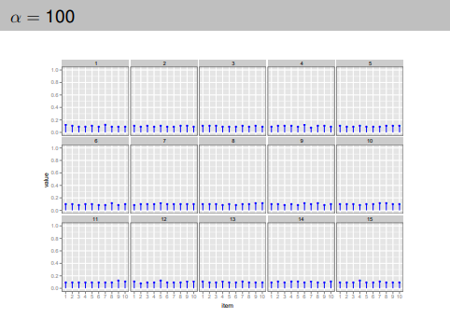
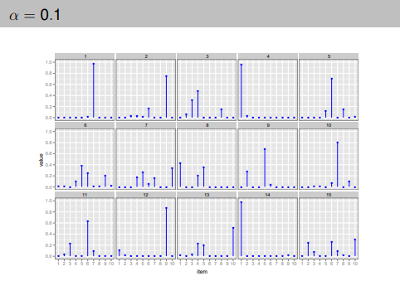
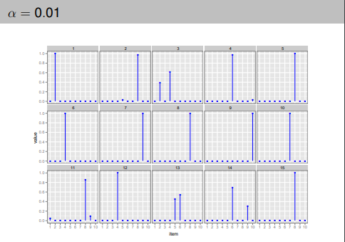

Slide 48
A uniform Beta value means we are treating all words in all topics equally
Similarly having some prior knowledge about certain topics, we can use different Beta values for each topic as Beta = [0.3, 1.7]
A higher Beta value for a topic i.e., above 1 suggests that the topic is a mixture of more or all words
Such a topic has its their probability spread across many words
This is when we want more words to represent a topic

Slide 49
A lower Beta value for a topic i.e., below 1 suggests that the topic is a mixture of fewer words
Such topics have fewer dominant words with higher probabilities
This is when we want only few words to represent a topic
Usually top few words in a topic having highest probabilities are used to represent a topic
In practice a high Beta value will lead to topics being more similar in terms of what words they contain

Slide 50
Evaluation techniques
Human (Expert based)
Extrinsic
Intrinsic

Slide 51
Human (Expert based)
Provide topics with intruded words taken from outside of the topic, where the human expert has to identify the intruded word
Mix halves of two topics together and the expert has to set them apart
Provide an intruded topic among the topics extracted by the model and the expert has to identify it
Finally precision and recall is calculated for the evaluations while using different number of top words to i.e., 5, 10, 20 to represent a topic
But human experts are expensive and hard to get

Slide 52
Extrinsic Evaluation
Using the top 10 or 20 words to represent a topic
Finding the distance between the words of a topic in an external resource (using any distance measure) that may be a semantic dictionary like WordNet, an extensive repository like Wikipedia or just a general language corpus
It doesn’t perform well for specialized domains as the words making sense together in a specialized domain may not do so in WordNet of general language
Even some domain specific words or alpha-numeric tokens may not be known to such repositories
Misses the context

Slide 53
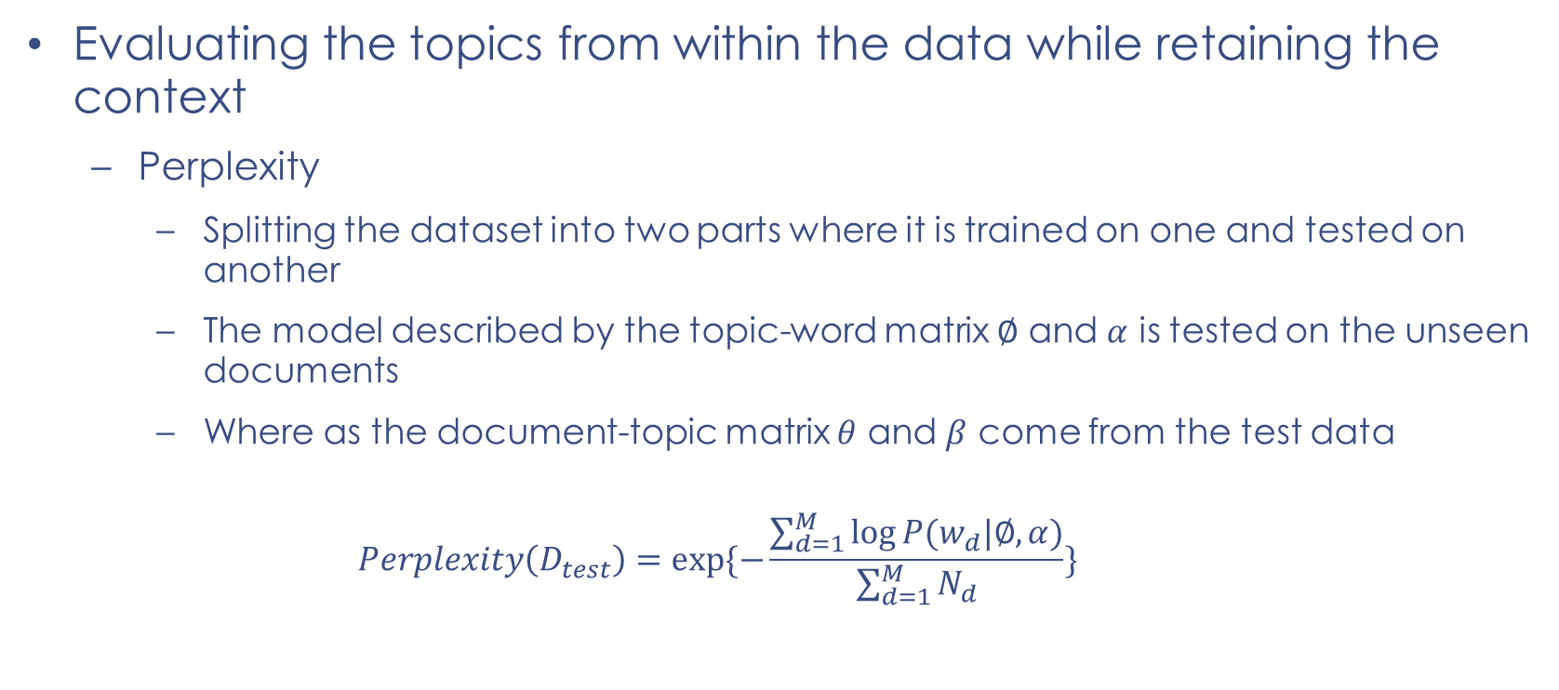
Intrinsic Evaluation
Evaluating the topics from within the data while retaining the context
Perplexity
Splitting the dataset into two parts where it is trained on one and tested on another
The model described by the topic-word matrix $∅$ and $α$ is tested on the unseen documents
Where as the document-topic matrix $θ$ and $β$ come from the test data
$$Perplexity\left(D_{test}\right)=exp⁡\{−\frac{\sum_{d=1}^{M}{\log{P(w_{d}|∅,α)}}}{\sum_{d=1}^{M}{N_{d}}}\}$$

Slide 54
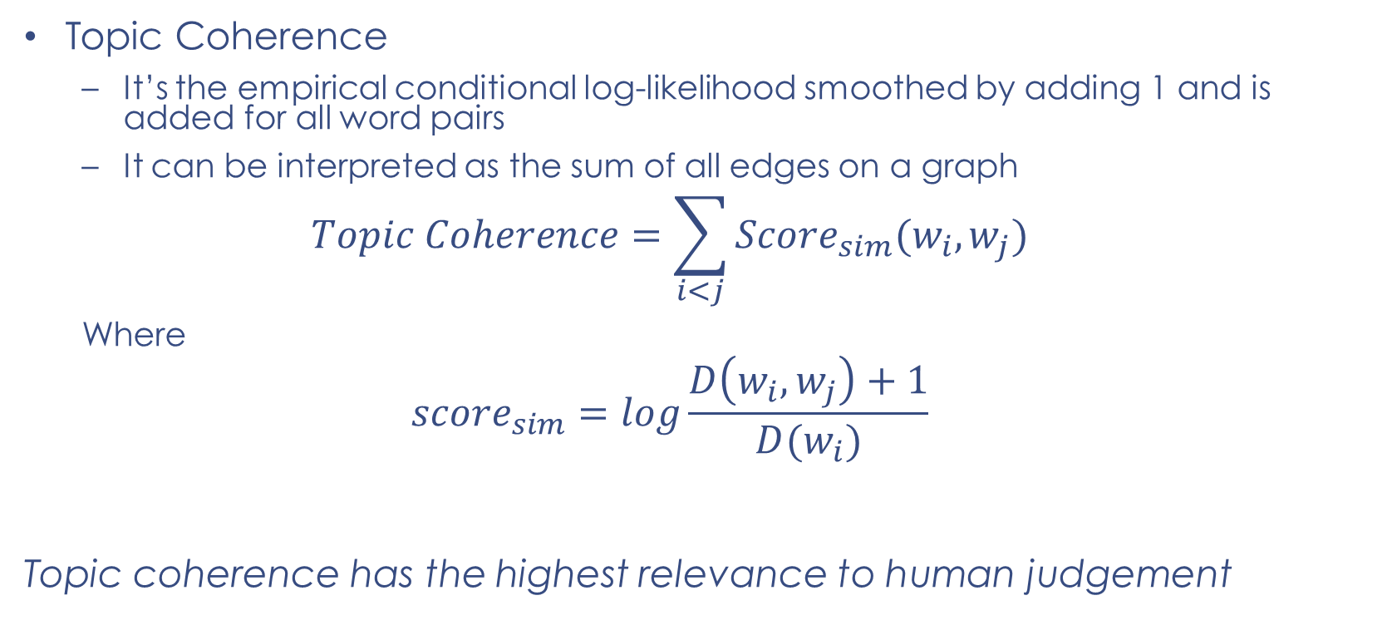
Topic Coherence
It’s the empirical conditional log-likelihood smoothed by adding 1 and is added for all word pairs
It can be interpreted as the sum of all edges on a graph
$$Topic Coherence=\sum_{i<j}{{Score}_{sim}(w_{i},w_{j})}$$
Where
$${score}_{sim}=log\frac{D\left(w_{i},w_{j}\right)+1}{D(w_{i})}$$
Topic coherence has the highest relevance to human judgement

Slide 55
Variants of Topic Models
Online LDA is an improvement on LDA model to be used for streaming data. The basic version can only be used with batch processing approach. Such model can be configured for streaming data from a Twitter, Facebook, YouTube or any other resource
With semi-supervised LDA, a human expert can hard bind certain words to topics and do not allow the model change it. However, using that arrangement the model group other words around them in their respective topics
With a supervised approach, the training data has few topics as labels for each document where the LDA has to pick a topic for each word in that document from within the labeled topics

Slide 56
Other Variants of Topic Models
Supervised topic models
Transfer learning topic models
Hybrid topic models
Online topic models
Hierarchical Topic models
Knowledge-based topic models
Lifelong learning based topic models

Slide 57
Conclusion

